Slide 1


Adiu.ai
30.111
Spring 2023
Adiu

Slide 2
Agenda
1. Company Vision
2. Short-Term Product
3. Long-Term Products
4. Roles of Co-founders
5. Co-founder Relationships
6. Equity Split and Rewards
7. Team Management Measures

Slide 3
Company Vision
Adiu.ai
Serve for Speech
Adiu is a homonym to "audio", derived from the Latin word "adiutor" which means "assistant".
We are currently developing a platform to help speech-language pathologists detect their patients'
speech impairments with greater accuracy using AI.

Slide 4
Company Vision
Adiu.ai
​With the number of speech-related disorders increasing in the recent years, there is a growing demand for Speech-Language Pathologists in Singapore to serve children who require early intervention, as well as aging populations who require speech therapy [1] [2].
​
160
$9.9B
qualified Singapore speech therapists [3]
global speech therapy market in 2021 [4]
[1] https://www.sgh.com.sg/news/tomorrows-medicine/break-walls-between-pre-schools-and-early-intervention-study​
[2] Impacting Lives as a Speech-Language Therapist by Singapore Institute of Technology (https://www.youtube.com/watch?v=yYx_fmJ30mY​)
[3]https://www.msf.gov.sg/media-room/Pages/Number-of-qualified-therapists-in-Singapore-for-special-needs-children.aspx
[4]https://www.globenewswire.com/en/news-release/2022/10/31/2544350/0/en/Global-Speech-Therapy-Market-is-Expected-to-Reach-USD-17-Billion-by-2031-Says-AMR.html​

Slide 5
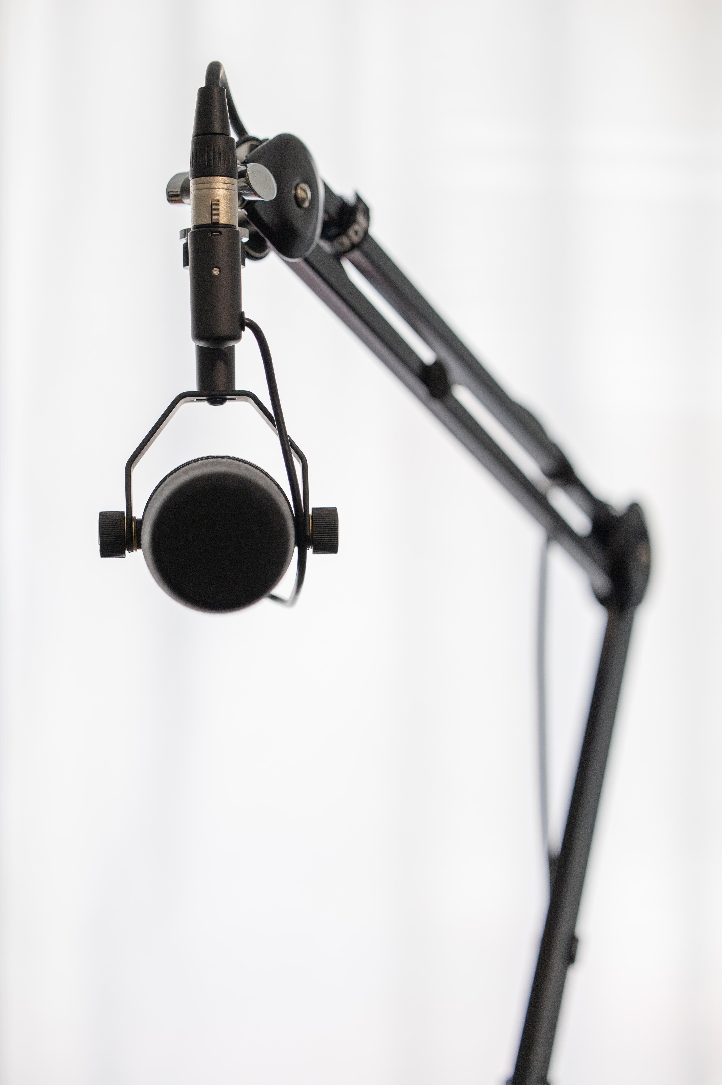
Short-Term Product
Adiu.ai
Reshaping Speech-Language Pathology Services using AI​
Automatic Speech Recognition is a Machine Learning technology that converts human speech into text.
ASR ML-algorithms are trained on audio data produced by the general human population.
Training the algorithm on audio data generated by patients with speech impairments can be used to detect characteristics of reduced speech intelligibility such as stuttering.
Implementing AI technologies in the field of healthcare can eliminate tedious clinical tasks such as manual annotations so that the speech-language pathologists can spend more time on diagnosis and treatment for patients.
Initial product will focus on determining a common neurodevelopmental disorder – stuttering.

Slide 6
Short-Term Product
Adiu.ai
patient audio
hours of manual annotations
diagnosis &
treatment plan
Adiu

Slide 7

3.Long-Term Products
Adiu.ai
2023
Automatic detection of one characteristic of speech impairments
MAKING A SHIFT IN THE INDUSTRY
Early adopters
Students enrolled in Speech and Language Therapy Undergraduate Programme at Singapore Institute of Technology.
Students enrolled in Speech and Language Pathology Masters Programme at National University of Singapore.
Evaluation
Extension of product
REPLACING
MANUAL ANNOTATION
BROADER
DETECTION OF FEATURES
DETECTION
OF ONE
FEATURE
Replacing manual annotation
Helping speech pathologists fully focus on what matters: serving their clients!

Slide 8
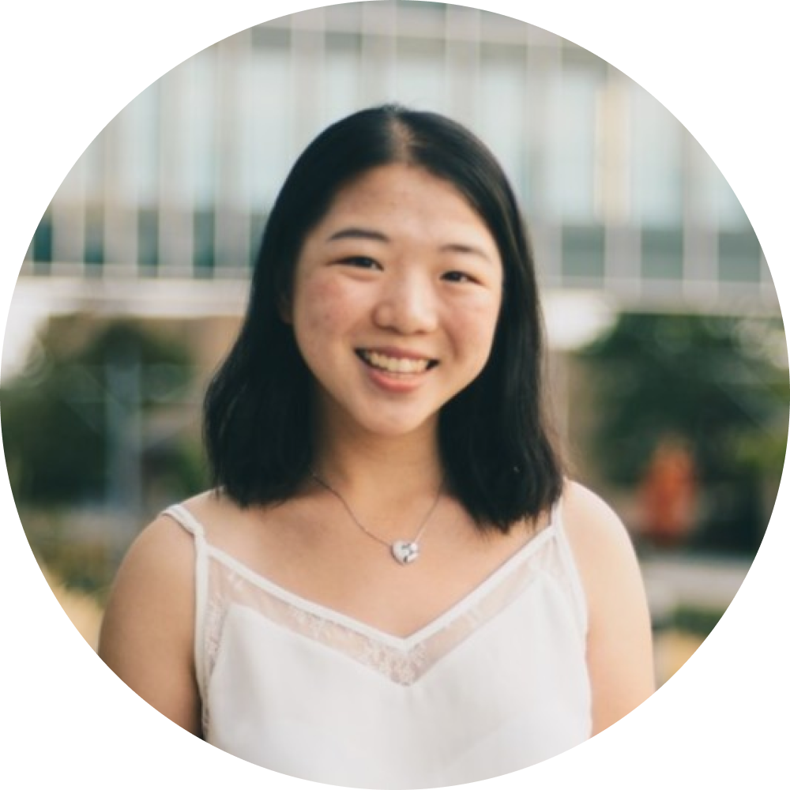
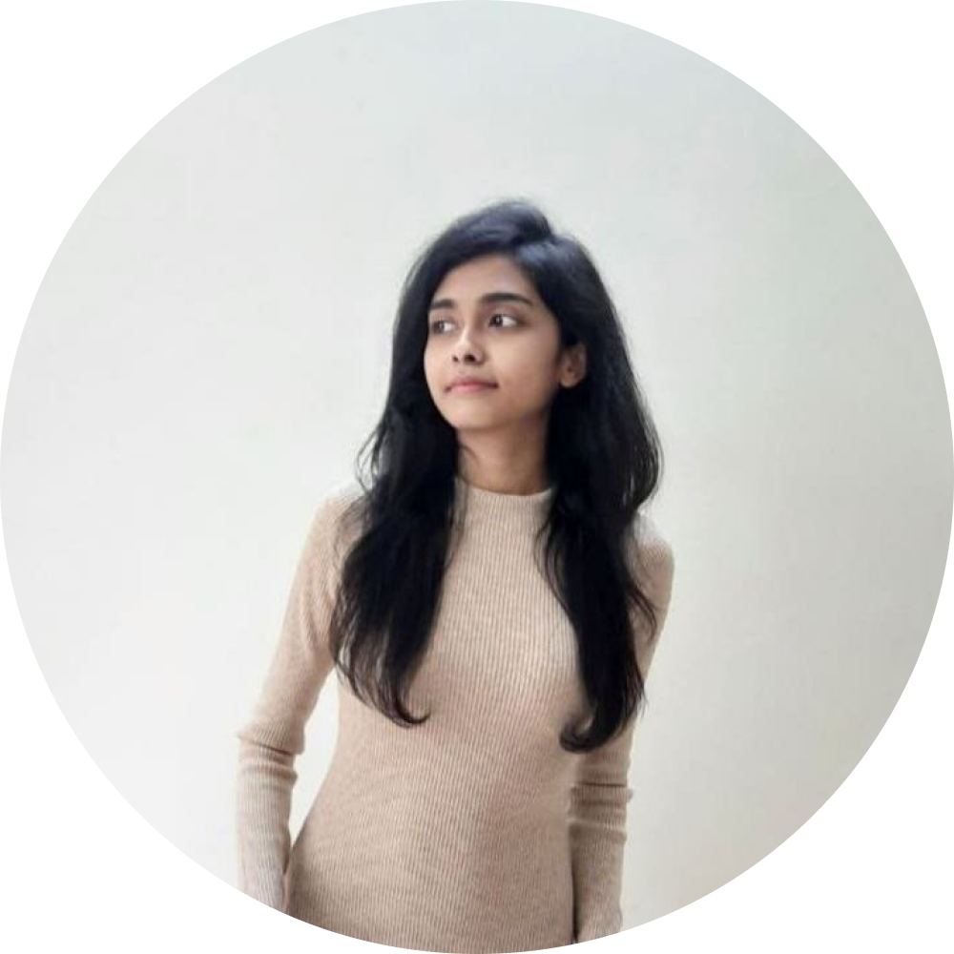
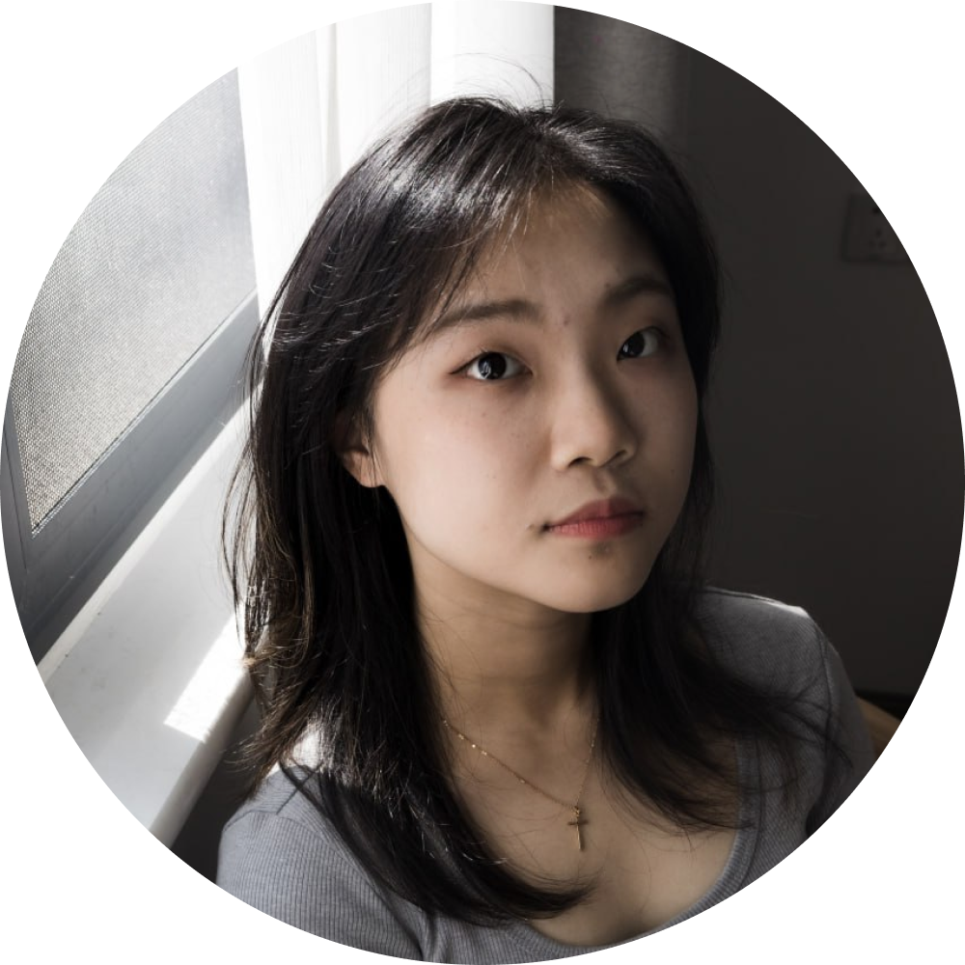
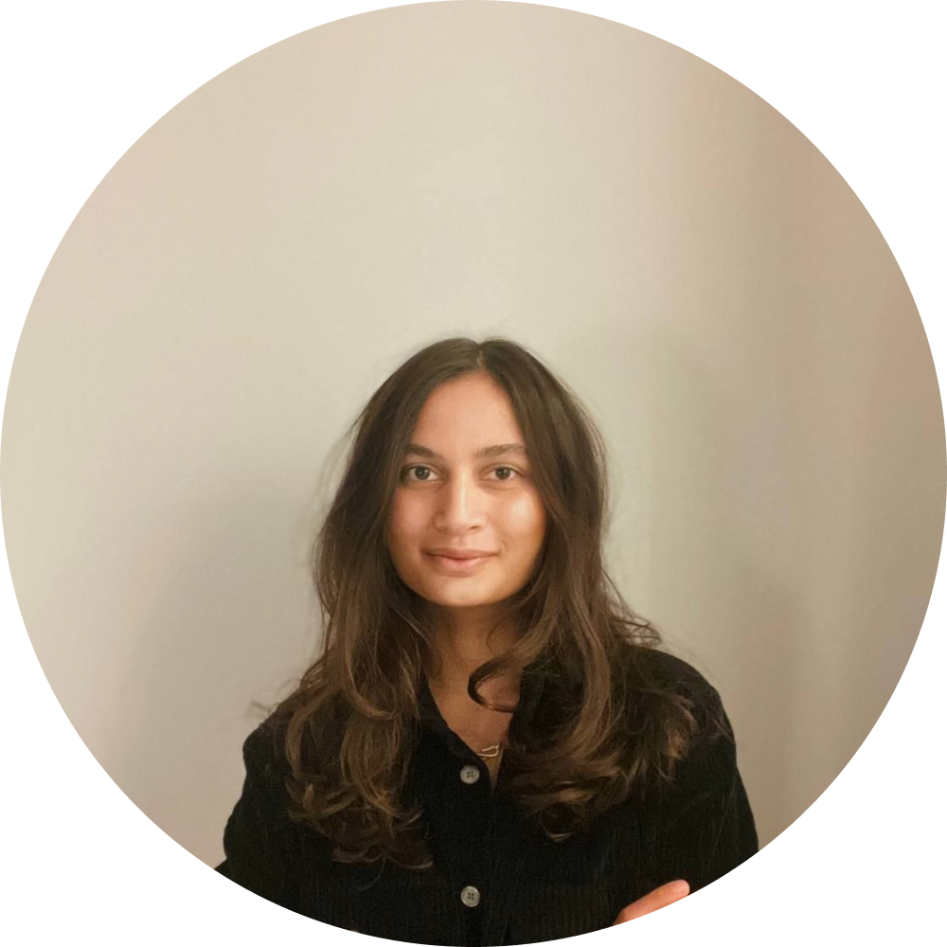
4.Roles of Co-Founders
Adiu.ai
Hanlin Cheng
Chief Executive Officer
🇨🇦 Canada
Adharsha Sam
Chief Technology Officer
🇮🇳 India
Eva Liu
Chief Product Officer
🇨🇳 China
Jackie Hellsten
Chief Design Officer
🇸🇪 Sweden
In-charge of spearheading the vision and broader strategic development
In-charge of product positioning and improving the product for better user experience
In-charge of product design,
user research and developing a high-quality experience
In-charge of identifying
innovative AI techniques
for product development

Slide 9
5.Co-Founder Relationships
Adiu.ai
Genesis
Team formed during 30.111 Match-Making studio session in Week 2.
Strengths
Shared Motivation: Shared buy-in for term project success &
the creation of a viable and valuable solution concept.
Diverse Team: Variety in educational backgrounds, expertise & skillsets is a strength.
University of Waterloo
Systems Design Engineering
SUTD
Data Science & Financial Services
Shanghai Jiao Tong University
Industrial Design
KTH Royal Institute of Technology
Interactive Media Technology
INTP (Logician)
Analytical
Original
Open-minded
Curious
Objective
INTJ (Architect)
Rational
Informed
Determined
Curious
Original
ENFJ (Protagonist)
Receptive
Reliable
Passionate
Altruistic
Charismatic
ENFJ (Protagonist)
Receptive
Reliable
Passionate
Altruistic
Charismatic

Slide 10
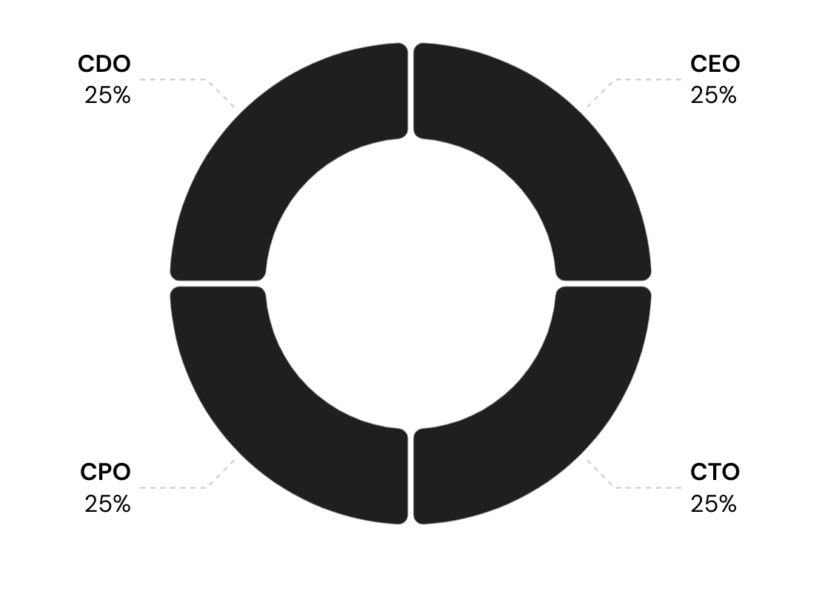
6.Equity Split and Rewards
Adiu.ai
TAM
$44B

Slide 11
Equity Split and Rewards
Adiu.ai
Equal Motivation
Setting the standard for shared incentive of successful execution [1].
Common Foundation
Level start and investment into the organization.
Long-term View
Anticipated equal distribution of responsibilities and accounting of share dilution [2]. Shared value creation.
Reasoning
[1] https://www.ycombinator.com/library/5x-how-to-split-equity-among-co-founders
[2] https://carta.com/blog/co-founder-equity-split/​

Slide 12
Equity Split and Rewards
Adiu.ai
 | Venture Fundraising | Marketing | Technology | Operations
Stakeholder 1 | CEO | CDO | CTO | CPO
Stakeholder 2 | CTO | CPO | CPO | CDO
Stakeholder 3 | CPO | CEO | CDO | CEO
Stakeholder 4 | CDO | CTO | CEO | CTO

Slide 13
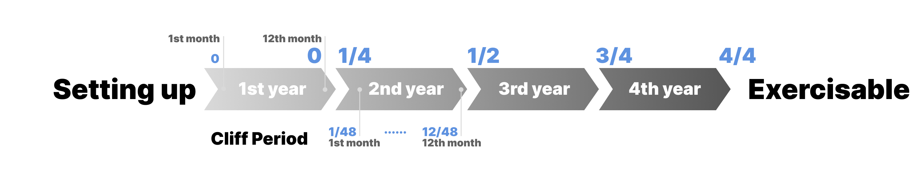
7.Team Management Measures
Adiu.ai
Vesting Schedule
CO-FOUNDERS
CORE WORKERS
20% of total equities be granted to 4 co-founders at the very beginning.
Remaining 80% vested gradually during the next 4 years.
​
Will hire field experts, software engineers, and marketing/growth folks to be core workers.
Set an option pool (made up of 4 x 2.5% of the equity).
​

Slide 14
Adiu.ai
Finis

